Slide 1

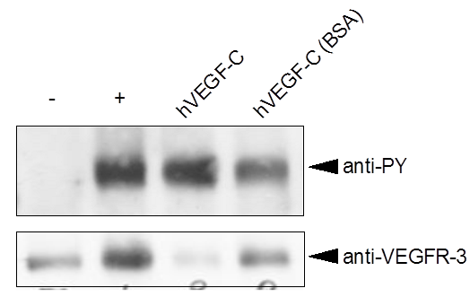
ReliaTech GmbH
Recombinant human VEGF-C
(Produced in Insect cells; Cat# 300-078)
Fig. 1: Biological activity was measured by its ability to induce VEGFR-3/FLT-4 receptor phosphorylation in PAEC cells expressing VEGFR-3/FLT-4.
http://www.reliatech.de / orders@reliatech.de

